Slide 1
Brexit
Alan V. Deardorff
University of Michigan
For presentation at Adult Learning Institute
Oakland Community College
April 11, 2017

Slide 2
Brexit
Defined: The exit of the United Kingdom from the European Union
What that actually means is now the subject of negotiation

Slide 3
Outline
European Union
The referendum and its aftermath
Issues to be negotiated
Options
Other problems to be addressed

Slide 4
European Union
What it is
A group of 28 countries
With zero tariffs on trade among them
Common tariffs and other trade policies for outside countries
Zero barriers to movement of
Goods
Services
People
Money (capital)
Headquarters: Brussels, Belgium
“The Four Freedoms”

Slide 5
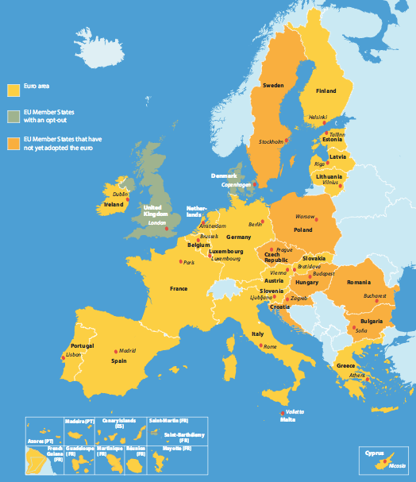
EU Members
Austria
Belgium Bulgaria Croatia Czech Repub.
Cyprus Denmark
Estonia
Finland
France
Germany
Greece Hungary
Ireland
Italy
Latvia
Lithuania
Luxembourg
Malta
Netherlands Poland
Portugal Romania
Slovakia
Slovenia
Spain Sweden U.K.
Notes:
http://europa.eu/european-union/about-eu/money/euro_en

Slide 6
European Union
History
Started with Treaty of Rome 1957, forming customs union of 6 countries
The European Economic Community
Belgium
France
Germany
Italy
Luxembourg
Netherlands

Slide 7
European Union
Others added:
1973
Denmark
Ireland
United Kingdom
1981
Greece
1986
Portugal
Spain
1973
Denmark
Ireland
United Kingdom
2004
10 more
2007
Bulgaria
Romania
2014
Croatia

Slide 8
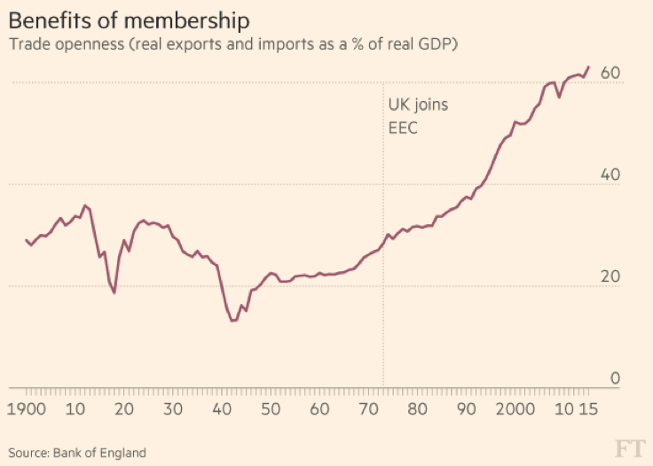
UK: Effects of EU Membership
Notes:
Source: Wikipedia

Slide 9
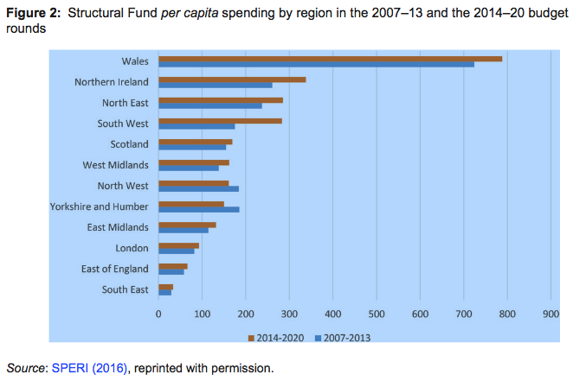
UK: Effects of EU Membership
From: Bell, “Regional aid policies after Brexit”
Notes:
Source: David N. F. Bell, “Regional aid policies after Brexit,” in Oxford Review of Economic Policy, Volume 33, Number S1, 2017, pp. S91–S104.

Slide 10
The Euro
EU does not require a common currency
The common currency, the euro, was adopted 1999
The Eurozone does not include
The United Kingdom
Denmark
Sweden
Some other recent entrants, so far

Slide 11
Outline
European Union
The referendum and its aftermath
Issues to be negotiated
Options
Other problems to be addressed

Slide 12
The Referendum
Held June 23, 2016
Why? Unhappiness with UK membership in EU
Migration
Regulations set by Brussels
Distrust of “elites” and “experts”
Not unhappy with trade

Slide 13
The Referendum
PM Cameron held referendum expecting “Remain” to win
It didn’t!
The vote:
Leave: 51.9%
Remain: 48.1%

Slide 14
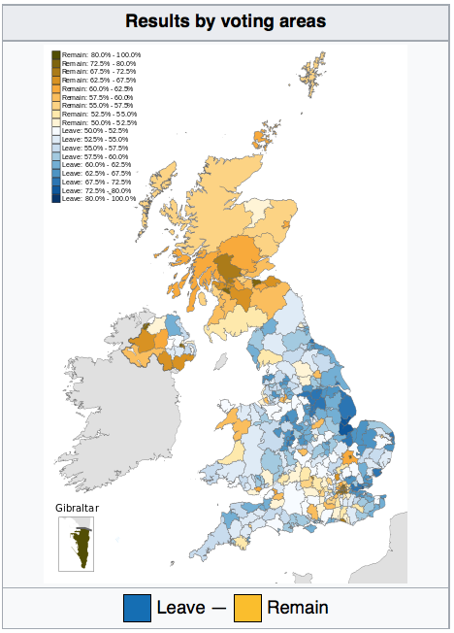
Notes:
Source: Wikipedia

Slide 15
The Referendum
Results of vote
Cameron stepped down as PM
Teresa May became PM
She had favored “Remain”
But promised to lead UK out of EU
British currency, the pound, fell to 30-year low
May did not trigger exit immediately
On March 29, 2017, invoked Article 50
This starts 2-year process of negotiation

Slide 16
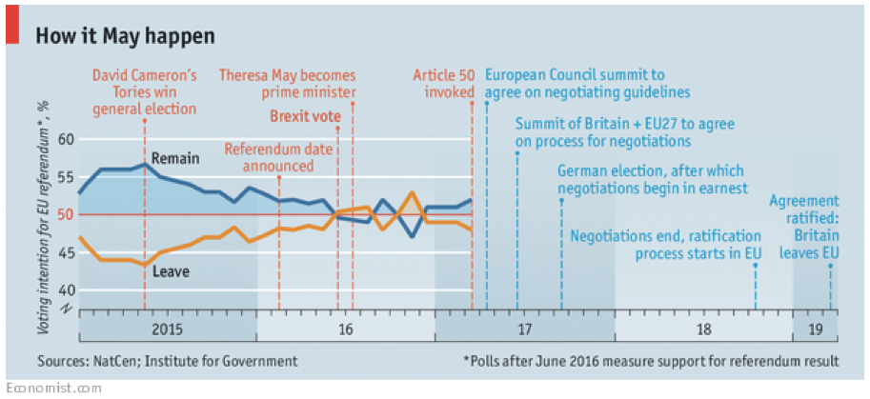
From: Economist, April 1, 2017, “The two-year countdown to Brexit has begun”
Notes:
Source: Wikipedia

Slide 17
Outline
European Union
The referendum and its aftermath
Issues to be negotiated
Options
Other problems to be addressed

Slide 18
The Negotiation
UK wants
Free access to the Single Market
For goods (zero tariffs & NTBs)
For services (especially financial)
Freedom to set its own regulations and tariffs
Freedom to restrict movement of people from EU

Slide 19
The Negotiation
EU wants
Free trade with UK
Free movement of people
No incentive for other EU members to exit

Slide 20
The Negotiation
The largest disagreement:
EU says access to Single Market must include free movement of people
UK says restricting movement of people is what Leave voters most wanted

Slide 21
The Negotiation
Other issues
The order of negotiations
EU wants to negotiate divorce first, then market access
UK wants to negotiate both together

Slide 22
The Negotiation
Other issues
The Exit Fee: How much must UK pay to cover its obligations. EU says UK owes €60 billion
Commitments under its seven-year budgetary framework
Investment commitments to be executed after Britain leaves the EU in 2019
Pensions

Slide 23
The Negotiation
Other issues
Extension of 2-year negotiation period
Will UK leave jurisdiction of European Court of Justice?
Will EU & UK citizens in UK & EU be allowed to remain?
Will the border between Ireland and Northern Ireland be closed?
Will British financial institutions retain their “passport” for operating in EU
Gibraltar

Slide 24
Outline
European Union
The referendum and its aftermath
Issues to be negotiated
Options
Other problems to be addressed

Slide 25
Options
There are three main options for Brexit:
Remain in Single Market
Negotiate Free Trade Agreement (FTA) with EU
Do nothing, and thus revert to only WTO rules

Slide 26
Options
1. Single Market
Become member of the European Economic Area, same as
Norway
Iceland
Liechtenstein

Slide 27
Options
1. Single Market
Requires:
Free movement of goods, services, people, and capital
Must implement all EU rules for
Employment
Consumer protection
Environmental policy
Competition policy
Pay a fee to the EU as contribution to the programs they participate in.

Slide 28
Options
1. Single Market
Does not require:
Monetary union
EU foreign & security policy
Justice
Home affairs policy
CAP
EU external tariff (not part of Customs Union)
But therefore free trade is subject to Rules of Origin

Slide 29
Options
2. FTA
Same as Switzerland and many other non-EU countries
Covers goods and may cover services and NTBs
Does not normally include free movement of people
Negotiating FTA
Usually takes years
Must include rules of origin

Slide 30
Options
3. WTO only
Same as US and others today
All trade subject to “MFN tariffs” and often NTBs

Slide 31
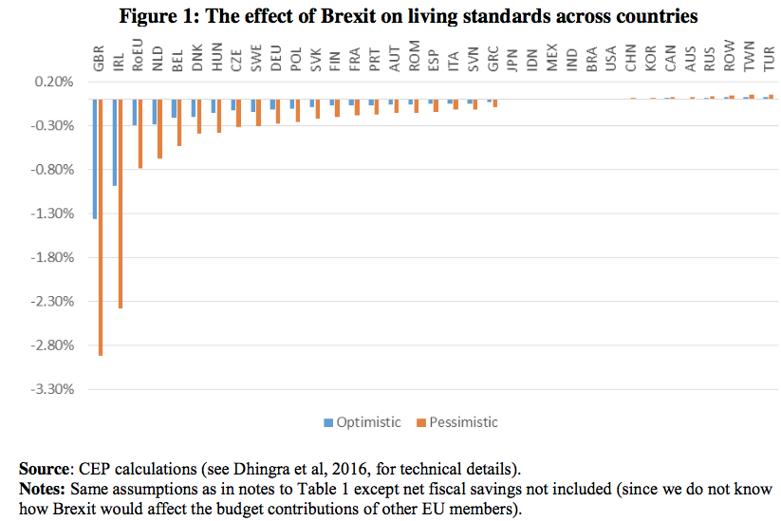
From: Dhingra et al, “The consequences of Brexit for UK trade and living standards”
Notes:
Source: Swati Dhingra, Gianmarco Ottaviano, Thomas Sampson and John Van Reenen, The consequences of Brexit for UK trade and living standards, Centre for Economic Performance, London School of Economics, Paper Brexit02, not dated.

Slide 32
Outline
European Union
The referendum and its aftermath
Issues to be negotiated
Options
Other problems to be addressed

Slide 33
Other Problems
Other FTAs
Will UK achieve free trade with the EU’s FTA partners (it has around 40 FTAs, some with multiple countries)?
Will UK be able to negotiate an FTA with the US?

Slide 34
Other Problems
Will UK hold together?
Will Brexit prompt Scotland to leave the UK?
Will Brexit prompt Northern Ireland to leave UK and join Ireland?

Slide 35
Conclusion
Brexit is not good for almost anybody
Best economic hope is that UK will join the EEA and remain in the Single Market
But then those who voted Leave will be very unhappy, even though they will be economically better off
Notes:
h

